Slide 1
Python Database Connection
Python Application
DataBase
Database
Driver
package
Written in python.
Collection of modules.
Modules contains reusable functions and objects.

Slide 2
Steps to download and install.
Pre-requisites
-> MySQL DB must be installed.
-> DataBase must be created.
-> Tables must be created.
MySQL Connector
A driver package which is used to established the connection with MySQL DataBase and the python file.
After establishing the connection we can run the queries.

Slide 3
Installation steps for mysql
Install mysql from
www.mysql.com
2. Developer zone.
3. Mysql Downloads.
4. Mysql Installer for windows.
5. Download for windows.

Slide 4
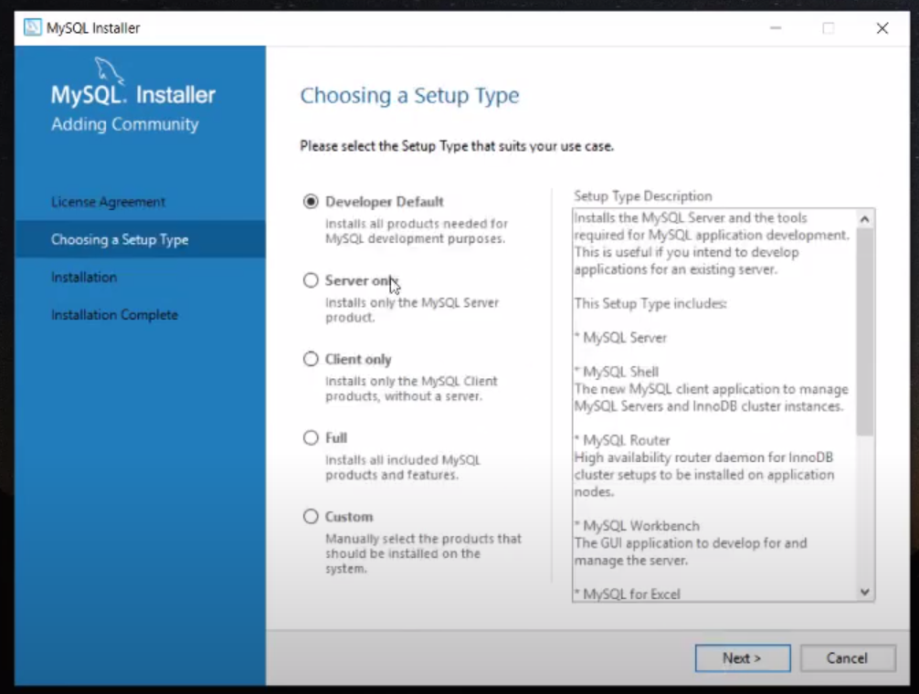
Steps to install MySQL server.

Slide 5
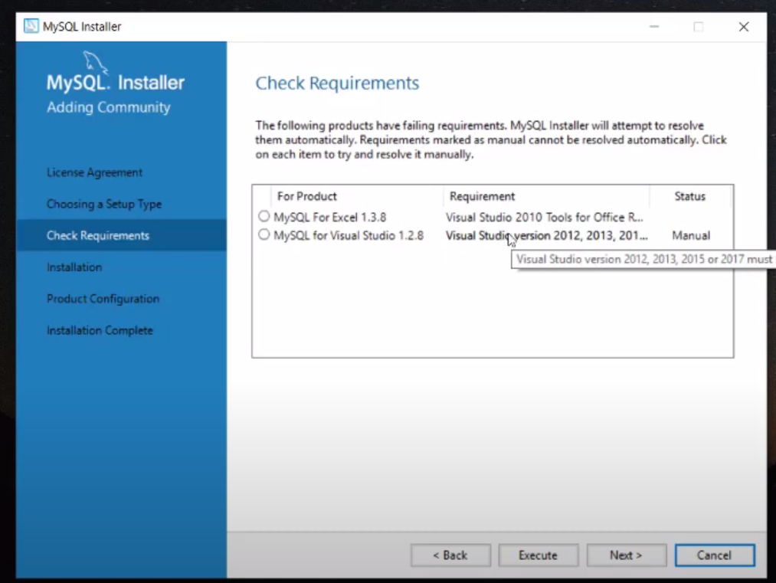

Slide 6
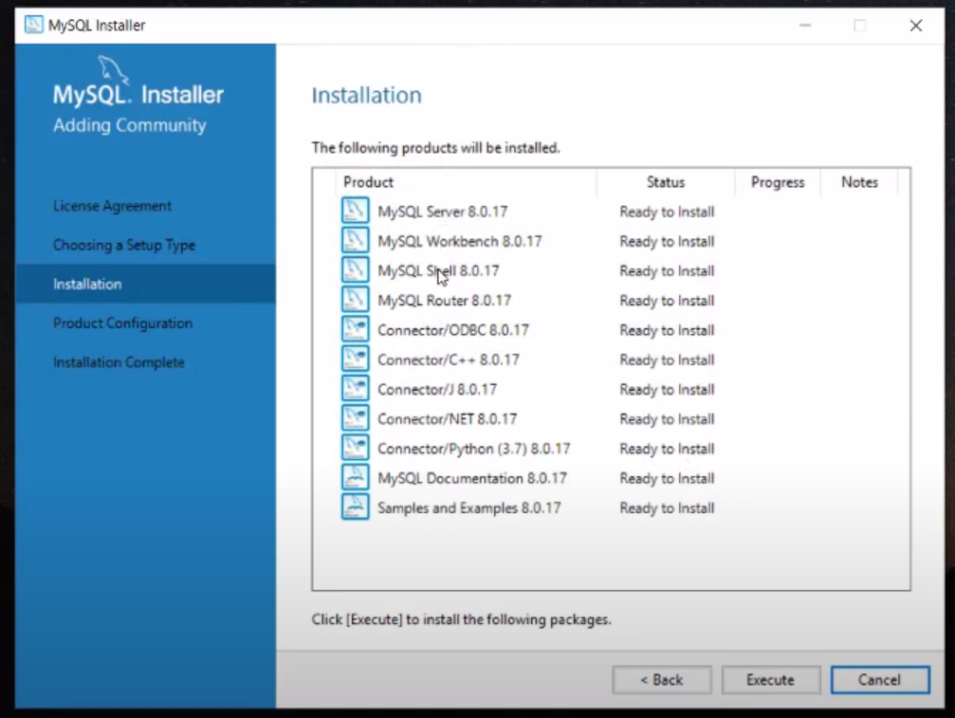

Slide 7
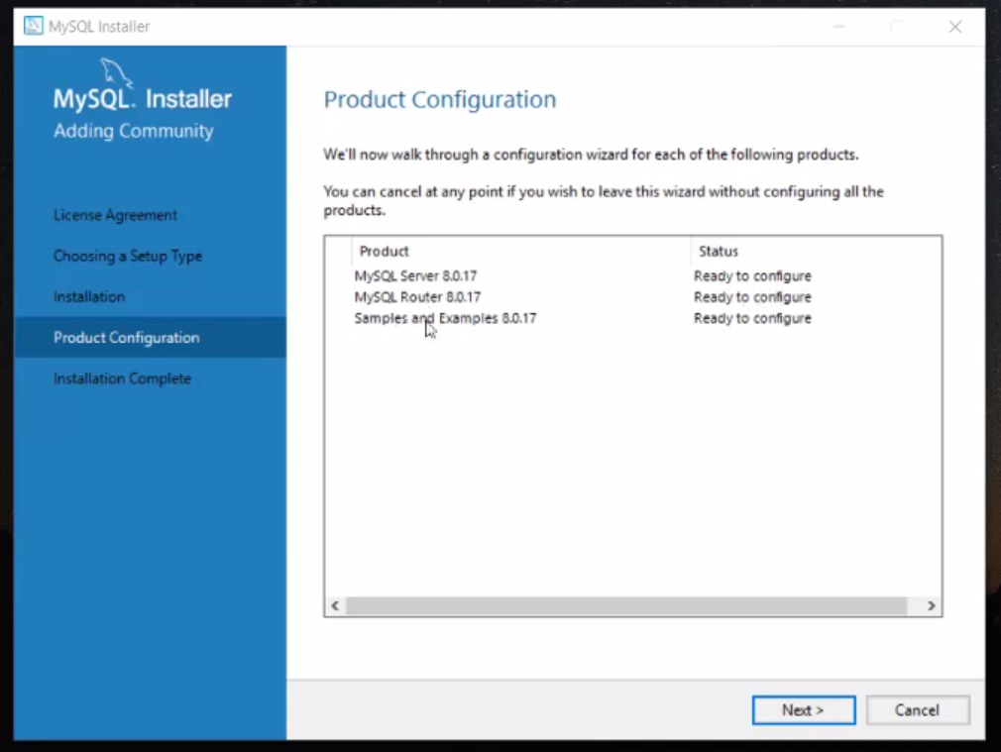

Slide 8
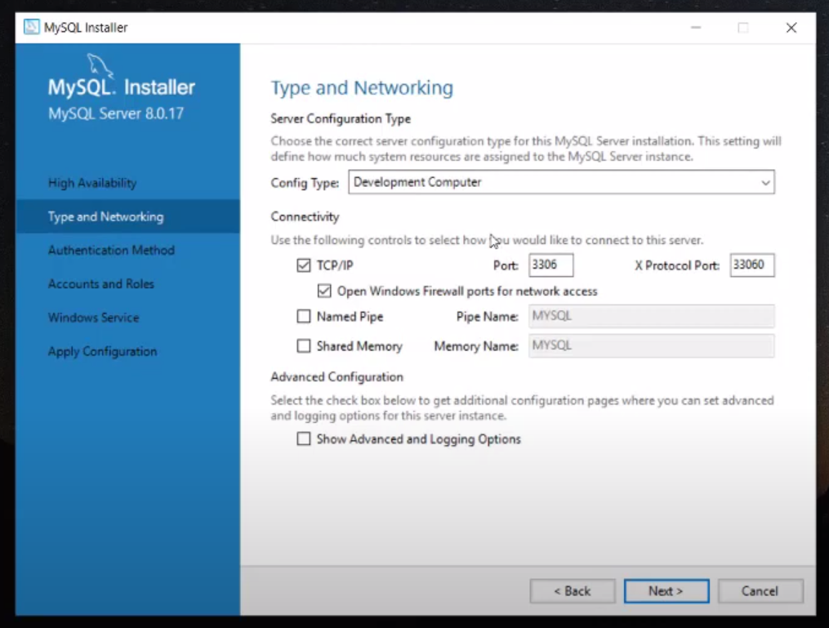

Slide 9
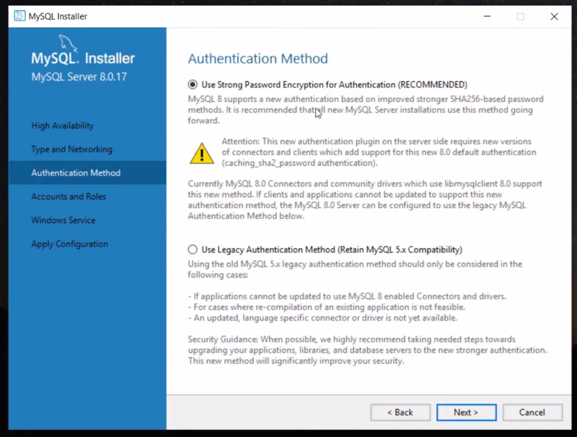

Slide 10
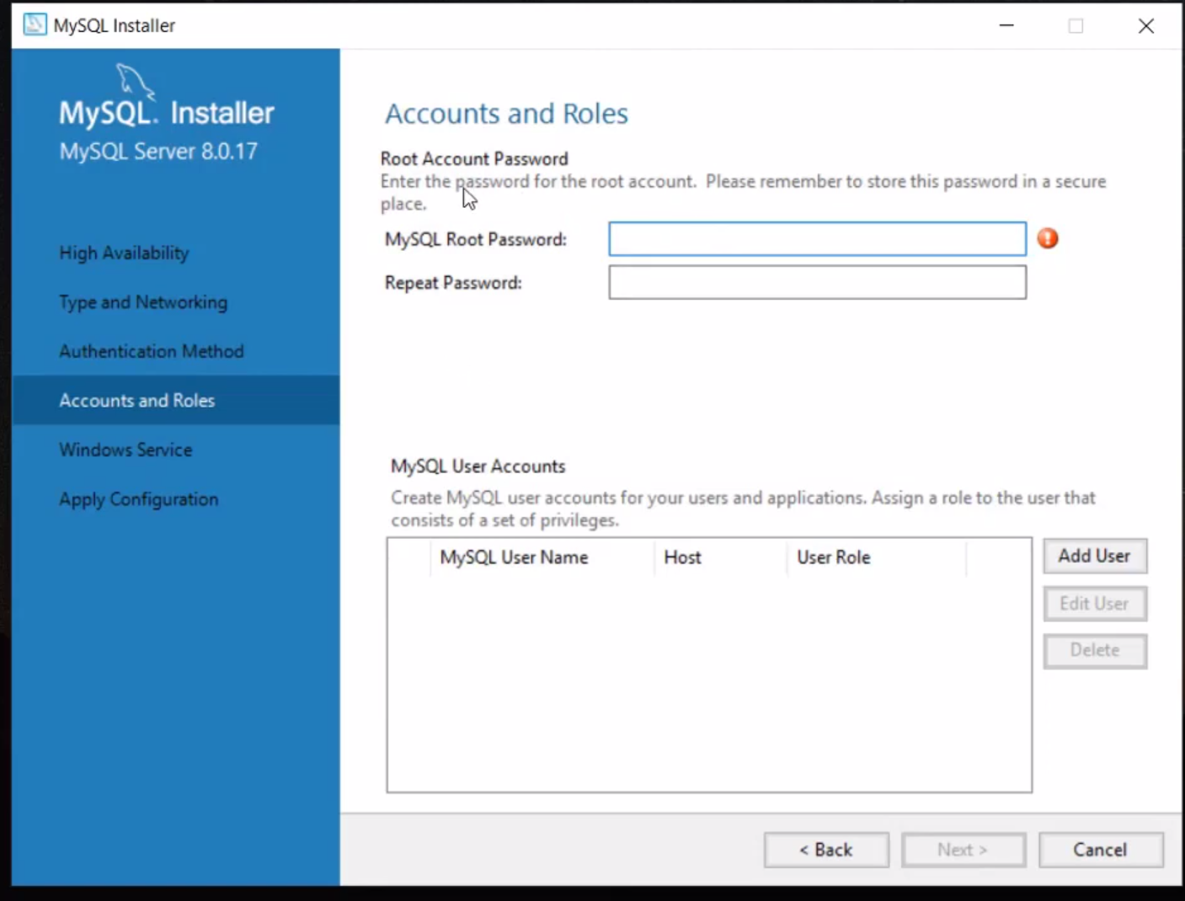

Slide 11
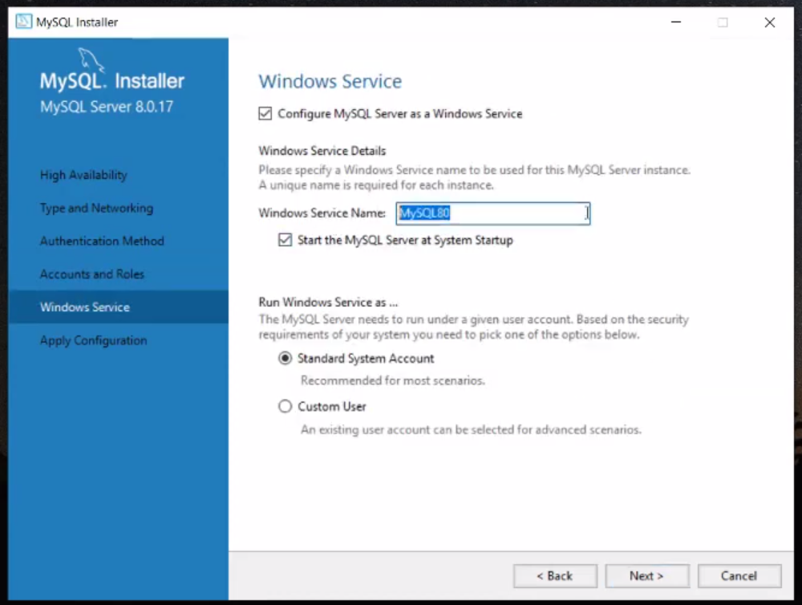

Slide 12
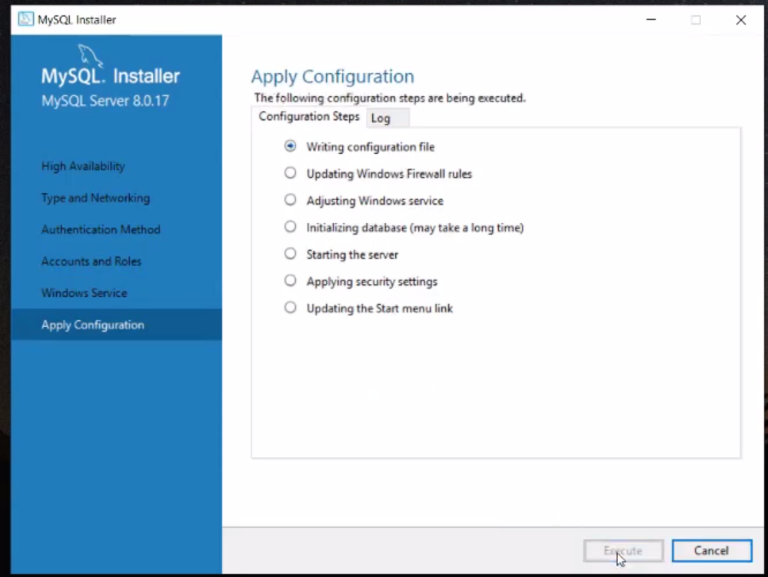

Slide 13
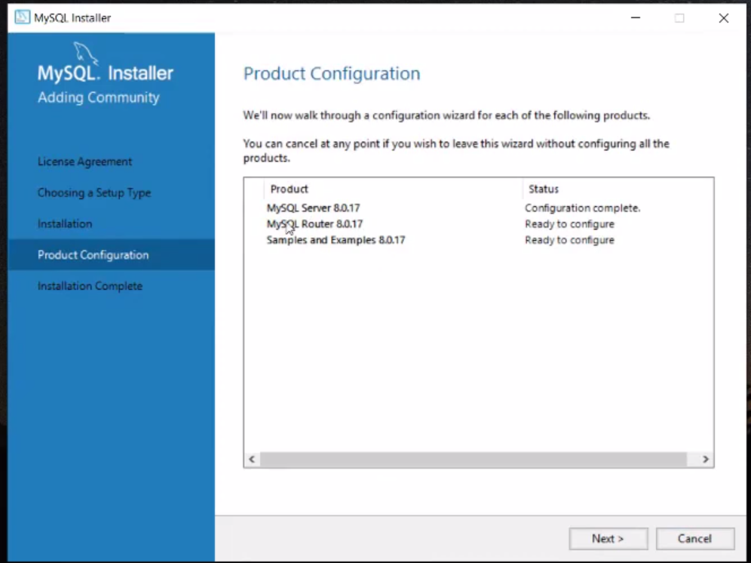

Slide 14
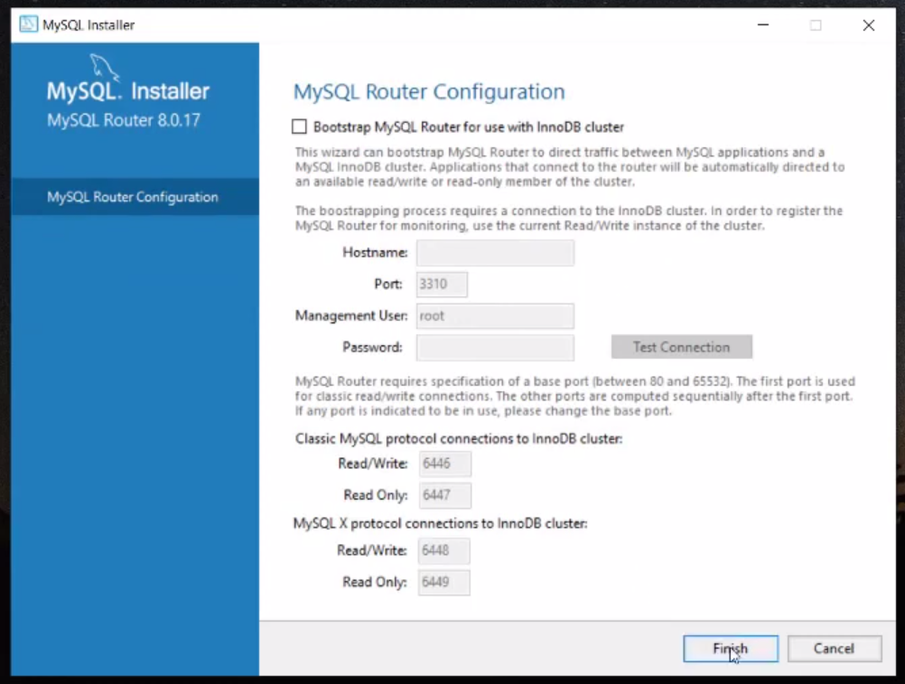

Slide 15
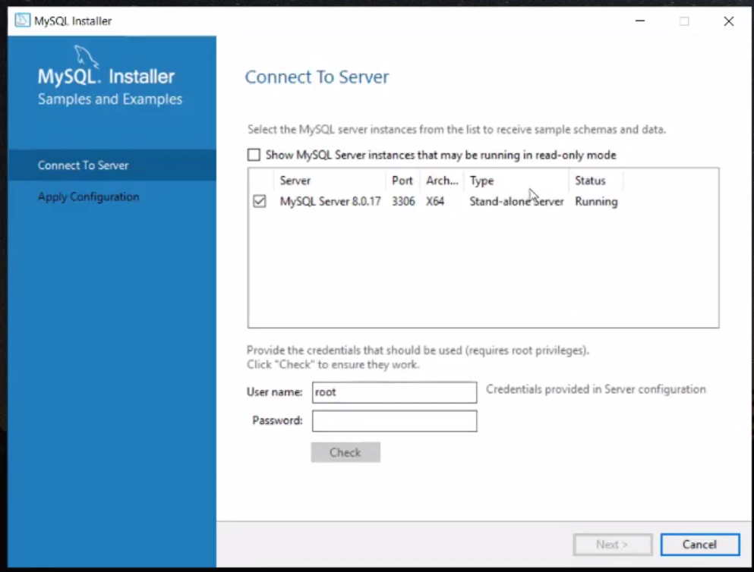

Slide 16
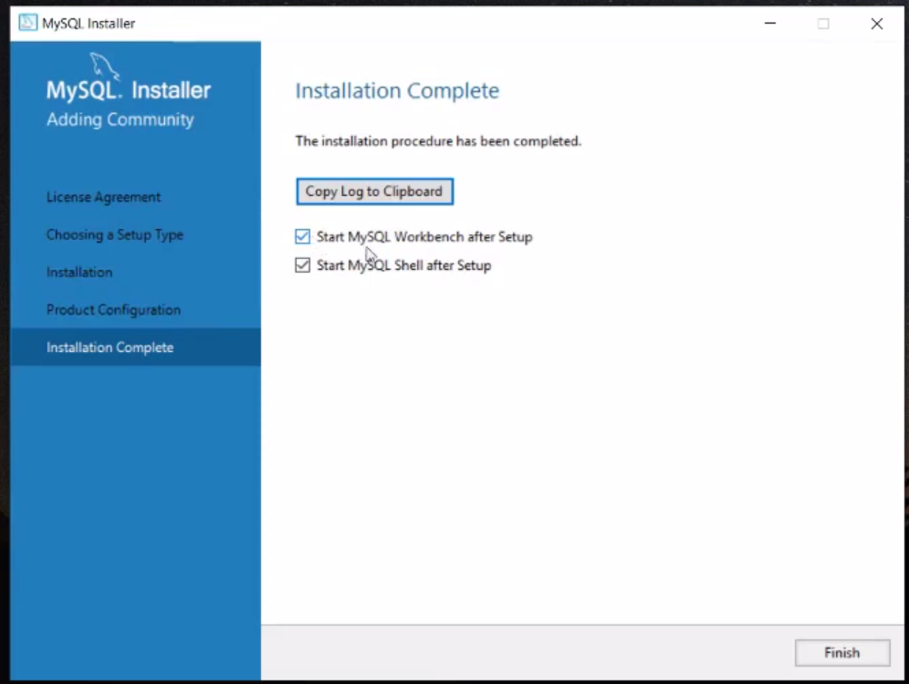

Slide 17
How to install external package
Using pip command
Syntax: -
pip install package_name
Ex:-
pip install mysql-connector-python

Slide 18
Steps to connect Python file and Database
Step 1 :- establish the connection between python file and Database
with the help of connect method
-> connect() is present in the mysql.connector module
Syntax : - con_obj = mysql.connector.connect( )
Step 2: - Create the cursor object using the connection object and cursor method ( )
Syntax : - cur_obj = con_obj.cursor( )
“ A cursor object represents the DB cursor ”

Slide 19
Step 3 : - Execute SQL Query using
cur_obj.execute( s )

